Slide 1

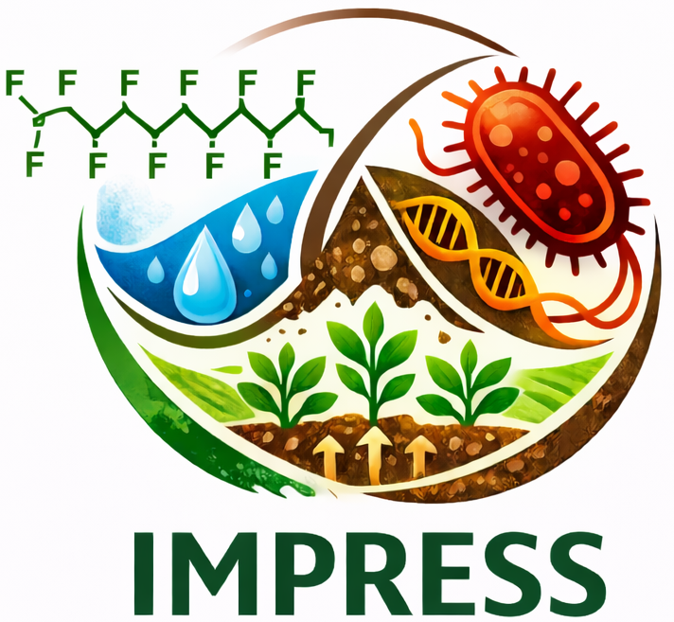

Łódź, 13.01.2026
Intersecting Hazards - Impact of PFAS on antimicrobial resistance spread
in sludge-fertilized soil (IMPRESS)
Call NCN Opus 29
Budget 1 474 199 pln
Duration 01.2026-01.2029
Magdalena Urbaniak (PI)

Slide 2
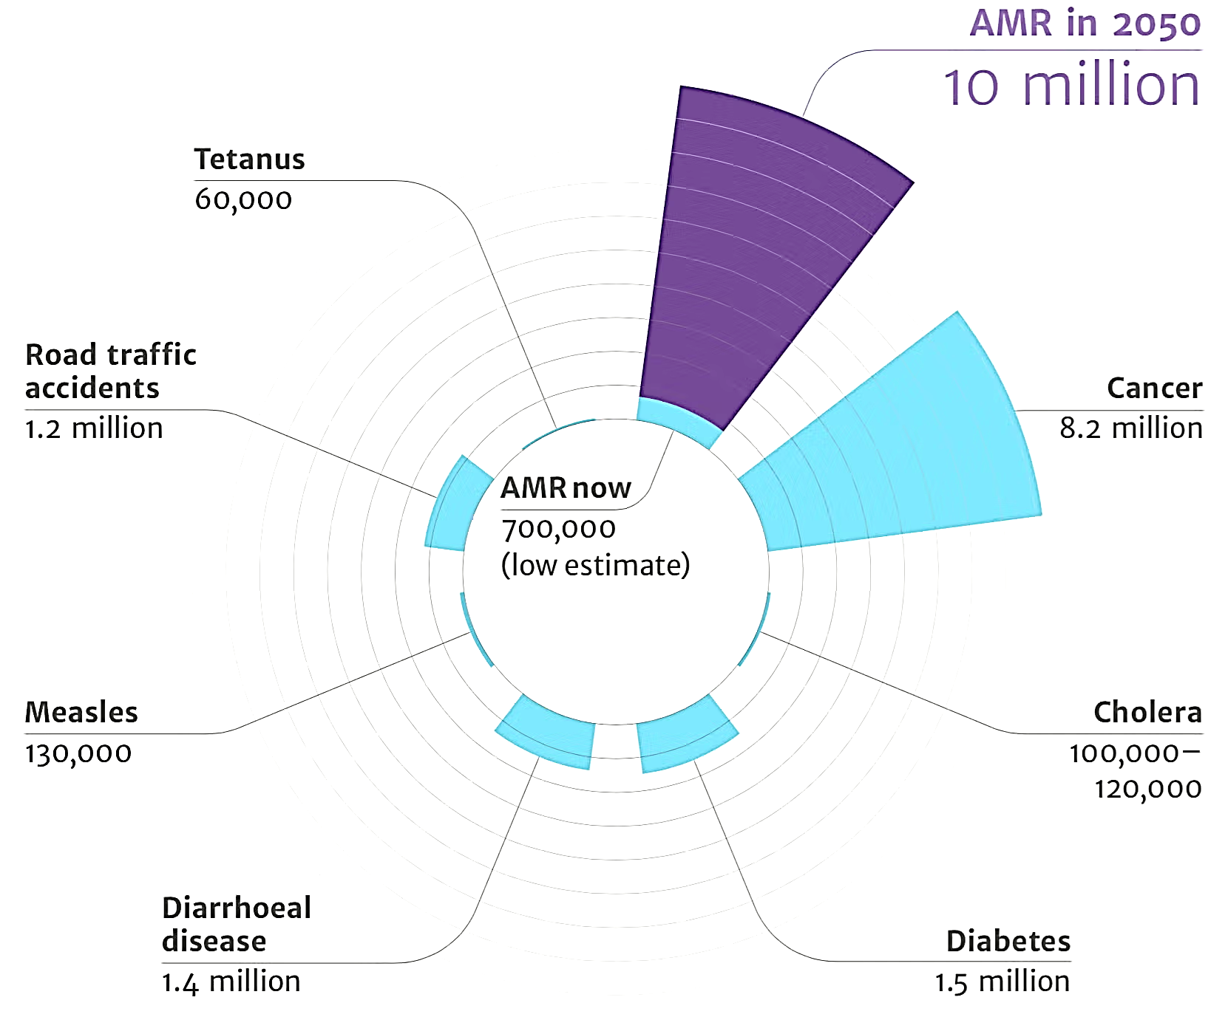
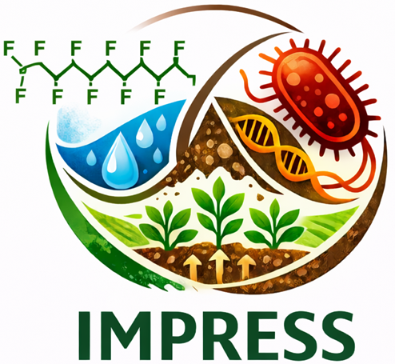

Heavy metals
PAHs
PCBs
Pesticides
Disinfectans
Nanomaterials
PFAS ???
Forever chemicals
https://healthpolicy-watch.news/antimicrobial-resistance-deaths-cancer/
11

Slide 3
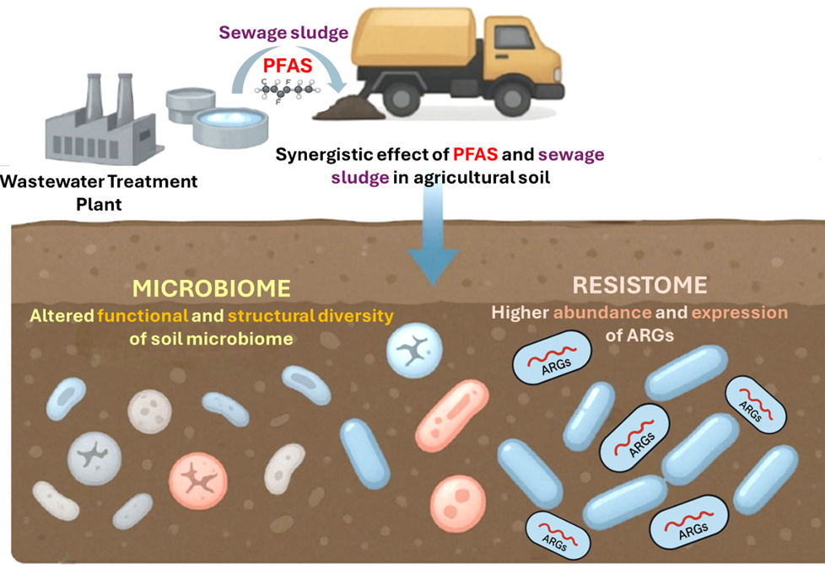
11

Slide 4
Research hypothesis:
The synergistic effect of PFAS and sewage sludge significantly alters the structure and functions of the bacterial community and increases the development of antimicrobial resistance in sludge-fertilized soil.
To test this hypothesis, the following research questions (RQs) will be explored:
RQ1 What are the concentrations and distribution patterns of PFAS in sludge and sludge-fertilized soils?
RQ2 How does PFAS contamination - present in sludge and artificially spiked at different concentrations - alter the concentrations and degradation dynamics of antimicrobials in sludge-fertilized soils?
RQ3 In what ways does PFAS - present in sludge and artificially spiked at different concentrations - reshape the microbial community structure and functional diversity in sludge-fertilized soils?
RQ4 How does PFAS - present in sludge and artificially spiked - influence the abundance, diversity,
and expression profiles of ARGs within the soil resistome?
RQ5 What are the cause-effect relationships between PFAS concentrations, microbiome shifts,
and resistome alterations in sludge-fertilized soils?
11

Slide 5



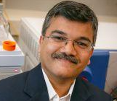
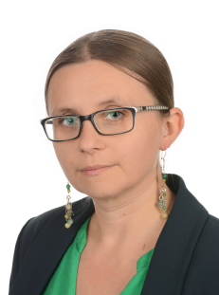
Leader
Partners
Prof. UL, dr hab. Magdalena Urbaniak
Principal Investigator
Prof. WUM, dr hab. Joanna Giebułtowicz
Investgator
Prof. Kuruntachalam Kannan
Investigator
2024-2027 –Controlling bioaccumulation potential of nonsteroidal anti-inflammatory drugs in cucurbits: safe crop production vs. effective pharmaceuticals removal.
OPUS NCN Budget: 1,129,634 PLN
2021-2025 –Microbial community, antibiotic resistance and physicochemical changes in soil amended with municipal sewage sludge. OPUS NCN Budget: 541,380 PLN
2014-2016 –Impact of sludge originated PCDDs/PCDFs on soil contamination and Salix sp. metabolism. SONATA NCN Budget: 353,500 PLN
Leader on PFAS research;
990 publications;
Scopus H-index of 146;
Citation number over 83000
The Kosciuszko Foundation Grant, 2018
The Bekker Programme, 2019
The Fulbright Senior Award, 2020-21
11

Slide 6
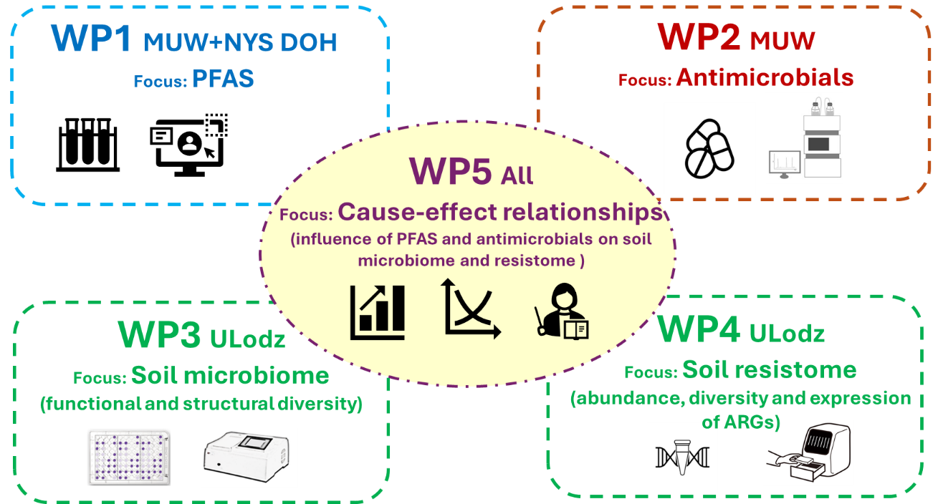
11

Slide 7


Thank you!

